Slide 1

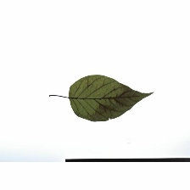

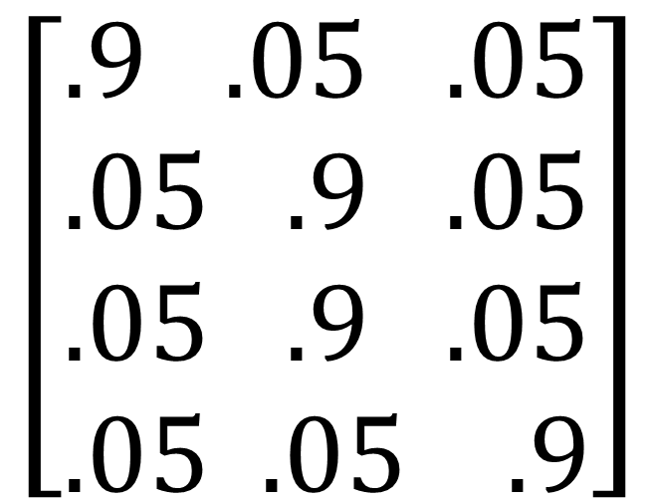
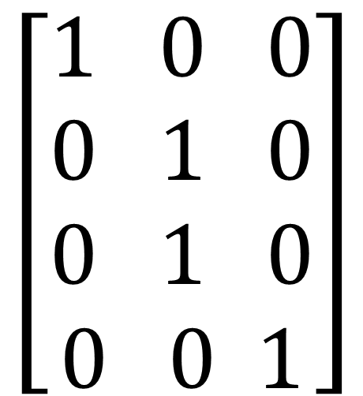
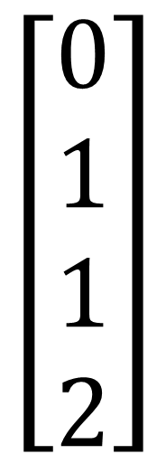
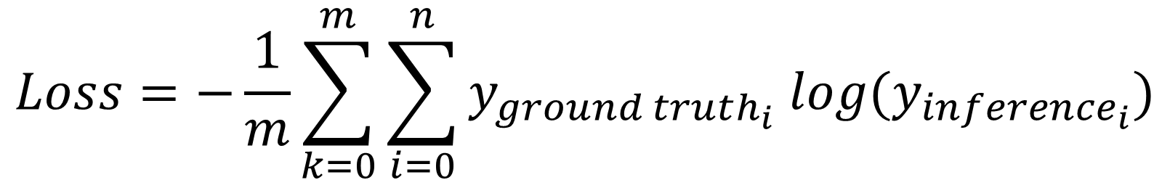
class0
class1
class2
class0
class1
class2
$$\left[\begin{aligned}1 0 0 \\ 0 1 0 \\ 0 1 0 \\ 0 0 1\end{aligned}\right]$$
$$\left[\begin{aligned}.9 .05 .05 \\ .05 .9 .05 \\ .05 .9 .05 \\ .05 .05 .9\end{aligned}\right]$$
class0
$$\left[\begin{aligned}0 \\ 1 \\ 1 \\ 2\end{aligned}\right]$$
class1
class1
class2
$$Loss=−\frac{1}{m}\sum_{k=0}^{m}{\sum_{i=0}^{n}{y_{ground truth_{i}} log⁡(y_{inference_{i}})}}$$

Slide 2
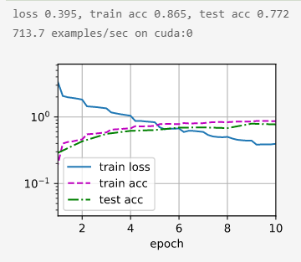
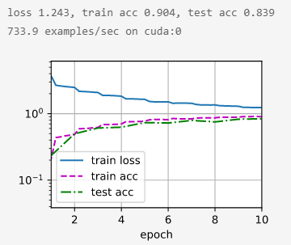
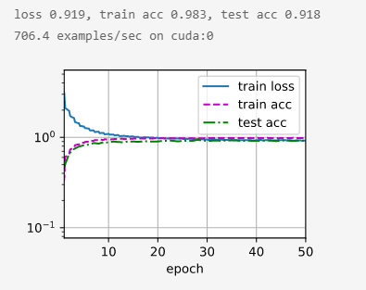
Without LSR
With LSR
With LSR, 50 epochs

